Slide 1
Measures of Dispersion
Range
Quartiles
Variance
Standard Deviation
Coefficient of Variation

Slide 2
Summary Definitions
The measure of dispersion shows how the data is spread or scattered around the mean.
The measure of location or central tendency is a central value that the data values group around. It gives an average value.
The measure of skewness is how symmetrical (or not) the distribution of data values is.
Basic Business Statistics, 11e © 2009 Prentice-Hall, Inc..
Chap 3-<number>

Slide 3
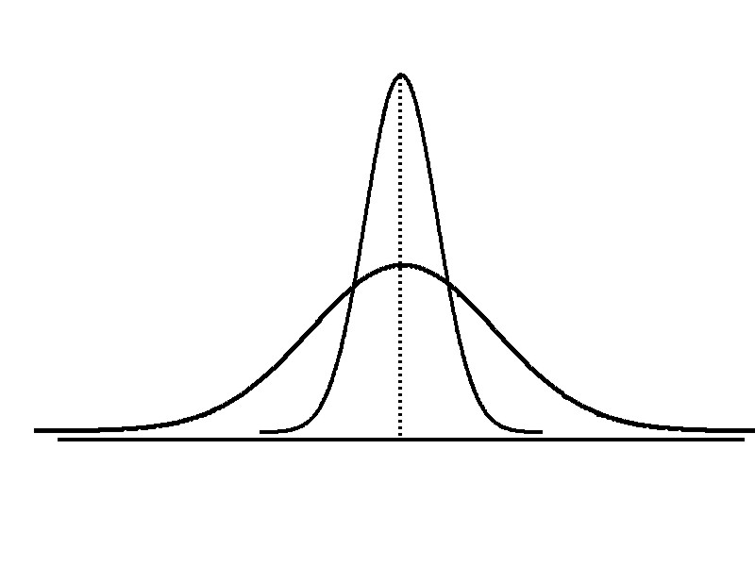
Measures of Dispersion
Variation
Range
Variance
Standard Deviation
Coefficient of Variation
Measures of variation give information on the spread or variability or dispersion of the data values.
Same centre,
different variation
Basic Business Statistics, 11e © 2009 Prentice-Hall, Inc..
Chap 3-<number>

Slide 4
Measures of Dispersion:
The Range
Simplest measure of dispersion
Difference between the largest and the smallest values:
Range = X_{largest} – X_{smallest}
Example:
0 1 2 3 4 5 6 7 8 9 10 11 12 13 14
Range = 13 - 1 = 12
Basic Business Statistics, 11e © 2009 Prentice-Hall, Inc..
Chap 3-<number>

Slide 5
Measures of Dispersion:
Why The Range Can Be Misleading
Ignores the way in which data are distributed
Sensitive to outliers
7 8 9 10 11 12
7 8 9 10 11 12
Range = 12 - 7 = 5
Range = 12 - 7 = 5
1,1,1,1,1,1,1,1,1,1,1,2,2,2,2,2,2,2,2,3,3,3,3,4,5
Range = 5 - 1 = 4
1,1,1,1,1,1,1,1,1,1,1,2,2,2,2,2,2,2,2,3,3,3,3,4,120
Range = 120 - 1 = 119
Basic Business Statistics, 11e © 2009 Prentice-Hall, Inc..
Chap 3-<number>

Slide 6
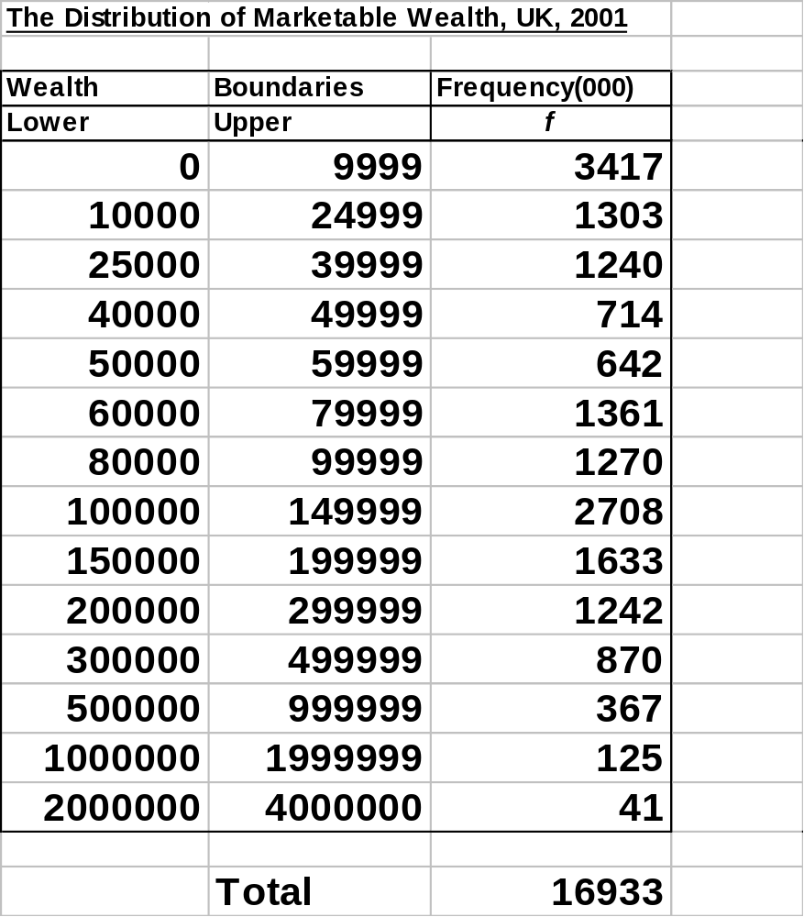
Range of Wealth
The range is
4 000 000 – 0
=£4 000 000

Slide 7
Quartile Measures
Quartiles split the ranked data into 4 segments with an equal number of values per segment
25%
25%
25%
25%
Q1
Q2
Q3
The first quartile, Q₁, is the value for which 25% of the observations are smaller and 75% are larger
Q₂ is the same as the median (50% of the observations are smaller and 50% are larger)
Only 25% of the observations are greater than the third quartile
Basic Business Statistics, 11e © 2009 Prentice-Hall, Inc..
Chap 3-<number>

Slide 8
Quartile Measures:
Locating Quartiles
Find a quartile by determining the value in the appropriate position in the ranked data, where
First quartile position: Q₁ = (n+1)/4 ranked value
Second quartile position: Q₂ = (n+1)/2 ranked value
Third quartile position: Q₃ = 3(n+1)/4 ranked value
where n is the number of observed values
Basic Business Statistics, 11e © 2009 Prentice-Hall, Inc..
Chap 3-<number>

Slide 9
Quartile Measures:
Locating Quartiles
Sample Data in Ordered Array: 11 12 13 16 16 17 18 21 22
(n = 9)
Q₁ is in the (9+1)/4 = 2.5 position of the ranked data
so use the value half way between the 2nd and 3rd values,
so Q₁ = 12.5
Q₁ and Q₃ are measures of non-central location
Q₂ = median, is a measure of central tendency
Basic Business Statistics, 11e © 2009 Prentice-Hall, Inc..
Chap 3-<number>

Slide 10
Quartile Measures
Calculating The Quartiles: Example
Sample Data in Ordered Array: 11 12 13 16 16 17 18 21 22
(n = 9)
Q₁ is in the (9+1)/4 = 2.5 position of the ranked data,
so Q₁ = (12+13)/2 = 12.5
Q₂ is in the (9+1)/2 = 5th position of the ranked data,
so Q₂ = median = 16
Q₃ is in the 3(9+1)/4 = 7.5 position of the ranked data,
so Q₃ = (18+21)/2 = 19.5
Q₁ and Q₃ are measures of non-central location
Q₂ = median, is a measure of central tendency
Basic Business Statistics, 11e © 2009 Prentice-Hall, Inc..
Chap 3-<number>

Slide 11
Quartile Measures:
Calculation Rules
When calculating the ranked position use the following rules
  If the result is a whole number then it is the ranked position to use
  If the result is a fractional half (e.g. 2.5, 7.5, 8.5, etc.) then average the two corresponding data values.
  If the result is not a whole number or a fractional half then round the result to the nearest integer to find the ranked position.
Basic Business Statistics, 11e © 2009 Prentice-Hall, Inc..
Chap 3-<number>

Slide 12
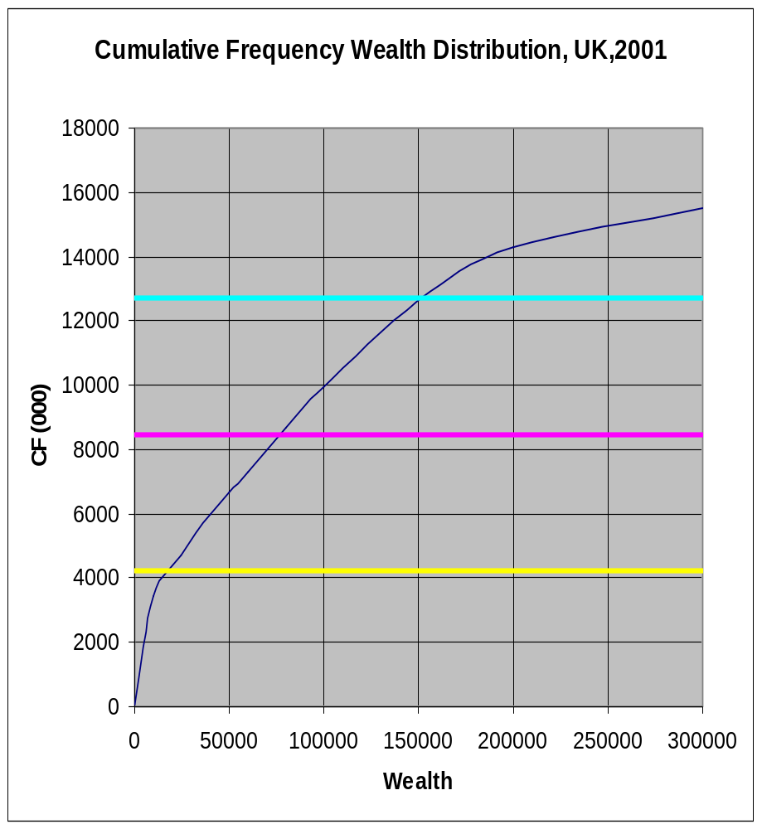
Quartiles of Wealth
The Lower Quartile
Q₁ = £19 396
The Upper Quartile
Q₃ = £151 370
The Inter-Quartile Range
IQR=£151 370-19 396
= 131 974

Slide 13
Quartile Measures:
The Interquartile Range (IQR)
The IQR is Q₃ – Q₁ and measures the spread in the middle 50% of the data
The IQR is a measure of variability that is not influenced by outliers or extreme values
Measures like Q₁, Q₃, and IQR that are not influenced by outliers are called resistant measures
Basic Business Statistics, 11e © 2009 Prentice-Hall, Inc..
Chap 3-<number>

Slide 14
Calculating The Interquartile Range
Example:
Median
(Q₂)
X
X
Q₁
Q₃
minimum
maximum
25% 25% 25% 25%
12 30 45 57 70
Interquartile range
= 57 – 30 = 27
Basic Business Statistics, 11e © 2009 Prentice-Hall, Inc..
Chap 3-<number>

Slide 15
The Boxplot or Box and Whisker Diagram
The Boxplot: A Graphical display of the data.
X_{smallest} -- Q₁ -- Median -- Q₃ -- X_{largest}
Example:
25% of data 25% 25% 25% of data
of data of data
X_{smallest} Q₁ Median Q₃ X_{largest}
Basic Business Statistics, 11e © 2009 Prentice-Hall, Inc..
Chap 3-<number>

Slide 16
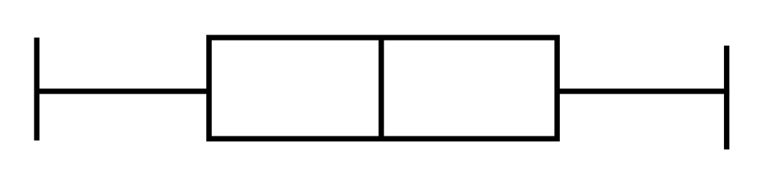
Shape of Boxplots
If data are symmetric around the median then the box and central line are centered between the endpoints
A Boxplot can be shown in either a vertical or horizontal orientation
X_{smallest} Q₁ Median Q₃ X_{largest}
Basic Business Statistics, 11e © 2009 Prentice-Hall, Inc..
Chap 3-<number>

Slide 17
Distribution Shape and
The Boxplot
Negatively-Skewed
Symmetrical
Positively-Skewed
Q₁
Q₂
Q₃
Q₁
Q₂
Q₃
Q₁
Q₂
Q₃
Basic Business Statistics, 11e © 2009 Prentice-Hall, Inc..
Chap 3-<number>

Slide 18
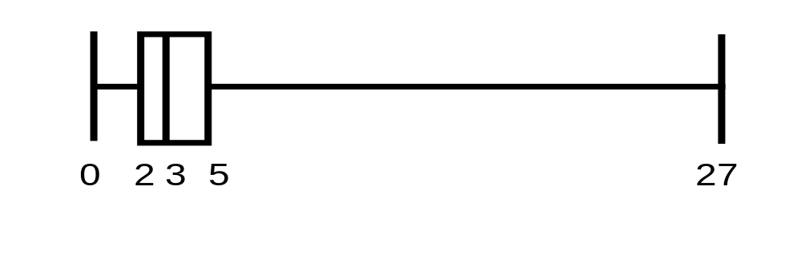
Boxplot Example
Below is a Boxplot for the following data:
0 2 2 2 3 3 4 5 5 9 27
The data are positively skewed.
X_{smallest} Q₁ Q₂ Q₃ X_{largest}
0 2 3 5 27
Basic Business Statistics, 11e © 2009 Prentice-Hall, Inc..
Chap 3-<number>

Slide 19
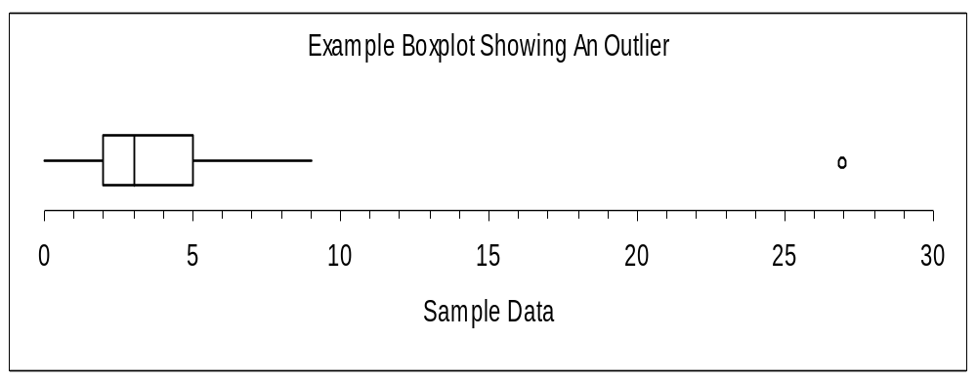
Boxplot example showing an outlier
The boxplot below of the same data shows the outlier value of 27 plotted separately
A value is considered an outlier if it is more than 1.5 times the interquartile range below Q₁ or above Q₃
Basic Business Statistics, 11e © 2009 Prentice-Hall, Inc..
Chap 3-<number>

Slide 20
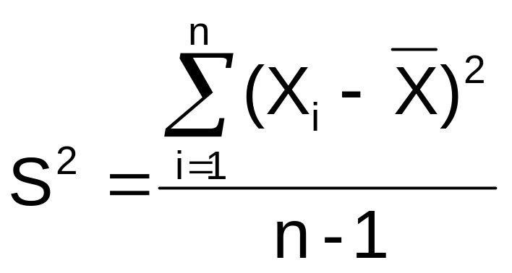

Measures of Dispersion:
The Variance
Average (approximately) of squared deviations of values from the mean
  Sample variance:
Where
= arithmetic mean
n = sample size
X_{i} = i^{th} value of the variable X
Basic Business Statistics, 11e © 2009 Prentice-Hall, Inc..
Chap 3-<number>

Slide 21
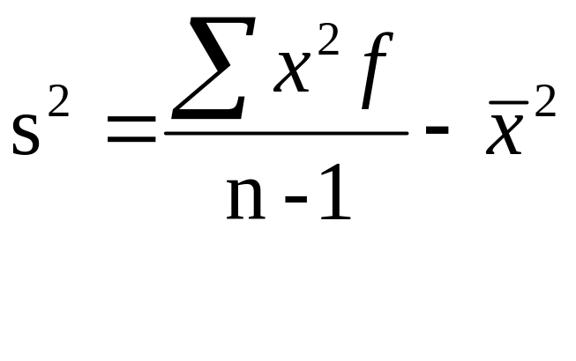

Another formula for Variance
Sample Variance
with frequency table
= arithmetic mean
n = sample size
X_{i} = i^{th} value of the variable X
= frequency

Slide 22
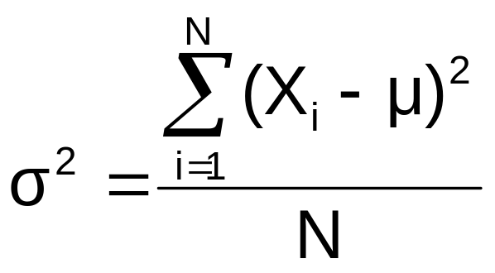
For A Population:
The Variance σ²
Average of squared deviations of values from the mean
  Population variance:
Where
μ = population mean
N = population size
X_{i} = i^{th} value of the variable X
Basic Business Statistics, 11e © 2009 Prentice-Hall, Inc..
Chap 3-<number>

Slide 23
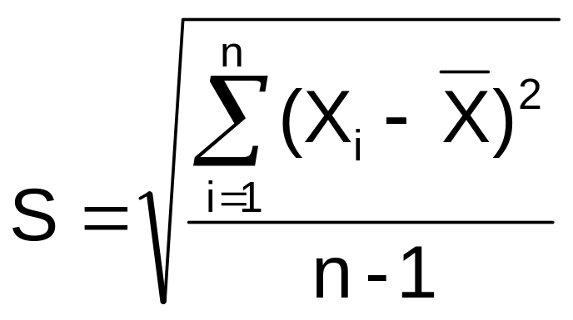
Measures of Dispersion:
The Standard Deviation s
Most commonly used measure of variation
Shows variation about the mean
Is the square root of the variance
Has the same units as the original data
  Sample standard deviation:
Basic Business Statistics, 11e © 2009 Prentice-Hall, Inc..
Chap 3-<number>

Slide 24
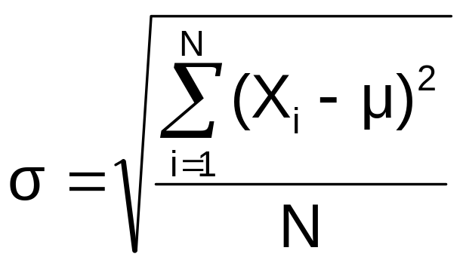
For A Population:
The Standard Deviation σ
Most commonly used measure of variation
Shows variation about the mean
Is the square root of the population variance
Has the same units as the original data
  Population standard deviation:
Basic Business Statistics, 11e © 2009 Prentice-Hall, Inc..
Chap 3-<number>

Slide 25
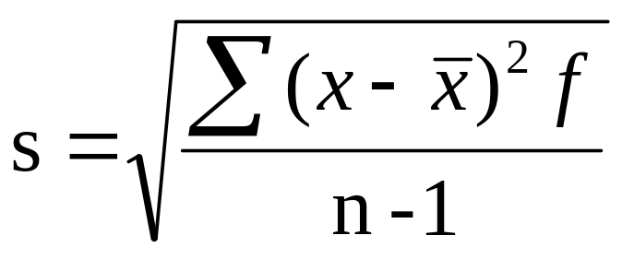
Approximating the Standard Deviation from a Frequency Distribution
Assume that all values within each class interval are located at the midpoint of the class
  Where n = number of values or sample size
    x = midpoint of the j^{th} class
    f = number of values in the j^{th} class
Basic Business Statistics, 11e © 2009 Prentice-Hall, Inc..
Chap 3-<number>

Slide 26
Summary of Measures
Range
X
–
X
Total Spread
largest
smallest
Standard Deviation
∑
(
2
Dispersion about
X
−
X
)
(Sample)
i
Sample Mean
n
−
1
Standard Deviation
∑
(
2
Dispersion about
X
−
μ
)
(Population)
i
X
Population Mean
N
Variance
Σ
2
Squared Dispersion
(
X
−
X
)
i
‾
(Sample)
n
about Sample Mean
– 1

Slide 27
Measures of Dispersion:
The Standard Deviation
Steps for Calculating Standard Deviation
1. Calculate the difference between each value and the mean.
2. Square each difference.
3. Add the squared differences.
4. Divide this total by n-1 to get the sample variance.
5. Take the square root of the sample variance to get the sample standard deviation.
Basic Business Statistics, 11e © 2009 Prentice-Hall, Inc..
Chap 3-<number>

Slide 28
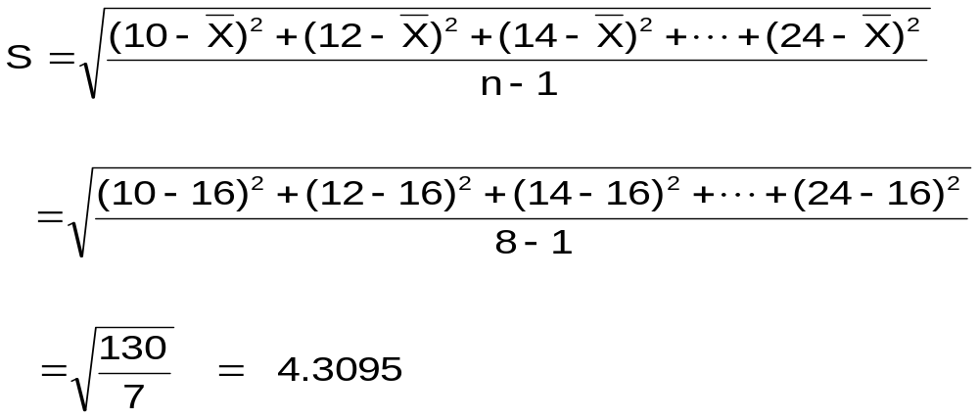
Measures of Dispersion:
Sample Standard Deviation:
Calculation Example
Sample
Data (X_{i}) : 10 12 14 15 17 18 18 24
n = 8 Mean = X = 16
A measure of the “average” scatter around the mean
Basic Business Statistics, 11e © 2009 Prentice-Hall, Inc..
Chap 3-<number>

Slide 29
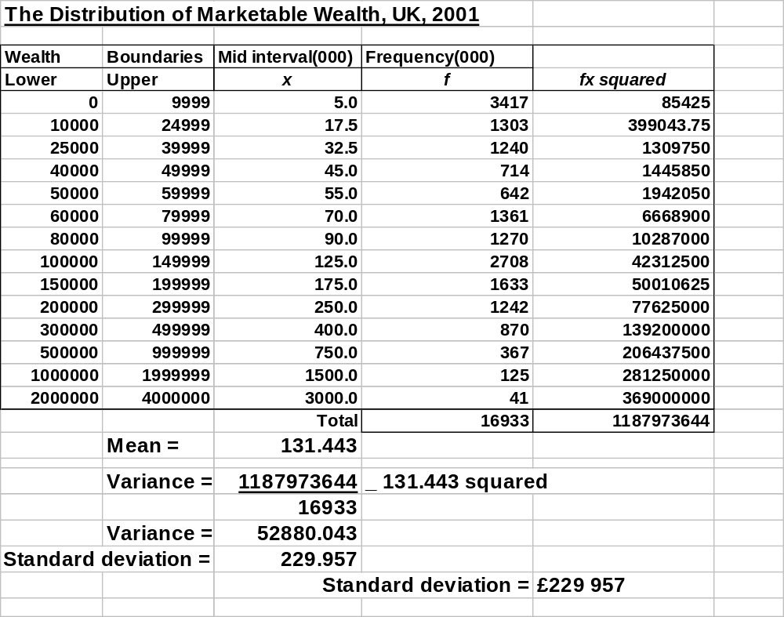
Standard Deviation of Wealth

Slide 30
Measures of Dispersion:
Comparing Standard Deviations
Data A
Mean = 15.5
S = 3.338
11 12 13 14 15 16 17 18 19 20 21
Data B
Mean = 15.5
S = 0.926
11 12 13 14 15 16 17 18 19 20 21
Data C
Mean = 15.5
S = 4.570
11 12 13 14 15 16 17 18 19 20 21
Basic Business Statistics, 11e © 2009 Prentice-Hall, Inc..
Chap 3-<number>

Slide 31
Measures of Dispersion:
Comparing Standard Deviations
Smaller standard deviation
Larger standard deviation
Basic Business Statistics, 11e © 2009 Prentice-Hall, Inc..
Chap 3-<number>

Slide 32
Measures of Dispersion:
Summary Characteristics
The more the data are spread out, the greater the range, variance, and standard deviation.
The less the data are spread out, the smaller the range, variance, and standard deviation.
If the values are all the same (no variation), all these measures will be zero.
None of these measures are ever negative.
Basic Business Statistics, 11e © 2009 Prentice-Hall, Inc..
Chap 3-<number>

Slide 33
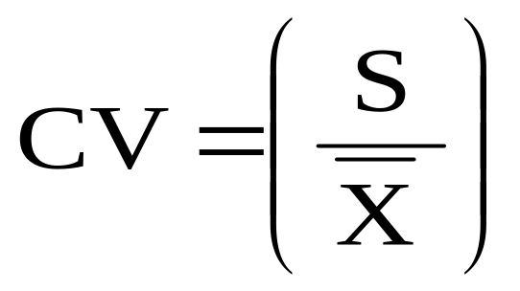
Measures of Dispersion:
The Coefficient of Variation
Measures relative variation
Always in percentage (%)
Shows variation relative to mean
Can be used to compare the variability of two or more sets of data measured in different units
Basic Business Statistics, 11e © 2009 Prentice-Hall, Inc..
Chap 3-<number>

Slide 34
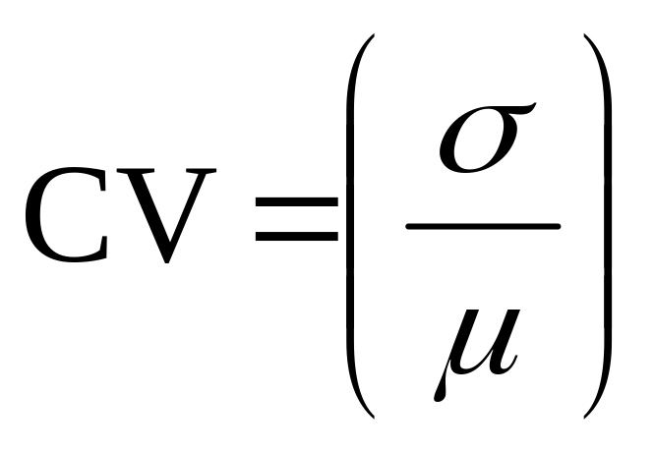
The Coefficient of Variation
Coefficient of Variation of a population:
This can be used to compare two distributions directly to see which has more dispersion because it does not depend on units of the distribution.

Slide 35
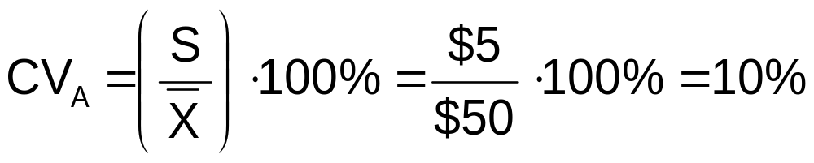
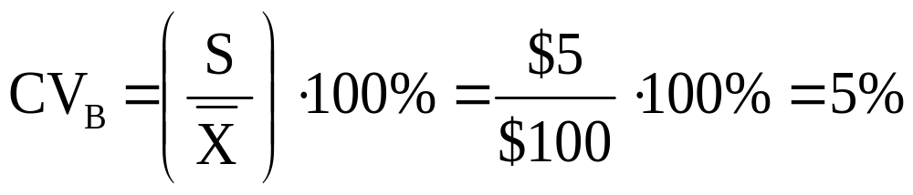
Measures of Dispersion:
Comparing Coefficients of Variation
Stock A:
  Average price last year = $50
  Standard deviation = $5
Stock B:
  Average price last year = $100
  Standard deviation = $5
Both stocks have the same standard deviation, but stock B is less variable relative to its price
Basic Business Statistics, 11e © 2009 Prentice-Hall, Inc..
Chap 3-<number>

Slide 36
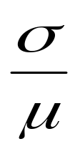
Coefficient of Variation of Wealth
Coefficient of variation =
=229.957 / 131.443
= 1.749
The standard deviation is 1.75% of the mean.

Slide 37
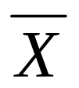





Sample statistics versus population parameters
Measure | Population Parameter | Sample Statistic
Mean
Variance
Standard Deviation
Chap 3-<number>

Slide 38
Pitfalls in Numerical
Descriptive Measures
Data analysis is objective
  Should report the summary measures that best describe and communicate the important aspects of the data set
Data interpretation is subjective
  Should be done in fair, neutral and clear manner
Chap 3-<number>

Slide 39

Ethical Considerations
Numerical descriptive measures:
Should document both good and bad results
Should be presented in a fair, objective and neutral manner
Should not use inappropriate summary measures to distort facts
Basic Business Statistics, 11e © 2009 Prentice-Hall, Inc..
Chap 3-<number>

